Slide 1



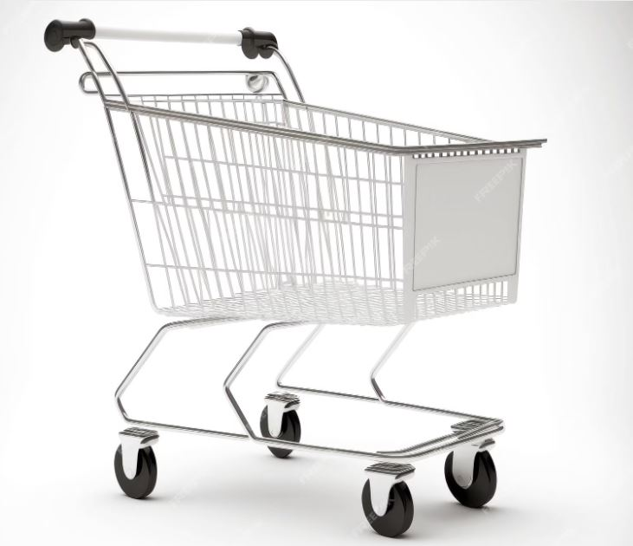
Supermarket Sales Project Presentation
Group 4 Team Members
1-Ahmed Nabil
2-Eman Gamal
3-Mohamed Hussein
4-Ahmed Karam
5-Mostafa Mohamed
Let’s Start our presentation!

Slide 2
Table of contents
01
Project Overview & Data Understanding
02
Data Cleaning & Transformation
03
Objectives Creation & Visualization
04
Key Insights & Conclusion
Clarify our dataset & Explain Project Goals
Explain the Details of data & Cleaning Methods
Create Objectives Using SQL & Python & Visualize Using Tableau & Power BI
Final Conclusion of the Project

Slide 3
01
Project Overview
Clarify our dataset & Explain Project Goals

Slide 4
Data Analysis of Super Market Data Set
Date : April 2025
Made by : Group No.4 DEPI Giza
Analyze a supermarket sales dataset to extract meaningful insights, identify sales patterns across categories and regions, and provide forecasting insights. The findings will be visualized in a dashboard and presented in a final report.

Slide 5
Data Understanding
Source
Columns
General Objectives
Kaggle / Excel CSV File
Kaggle Data Set Link
Invoice ID , Branch City Customer type ,Gender , Product line ,Unit price , Quantity , Tax 5% , Total sales , Date , Time ,Payment method ,
cogs (Cost Of Goods) ,
gross margin percentage , gross income Rating & GOGS/Sales
To Analyze Customers & sales Data from the data Set
Identify Patterns & Trends to support Bussiness Descions

Slide 6
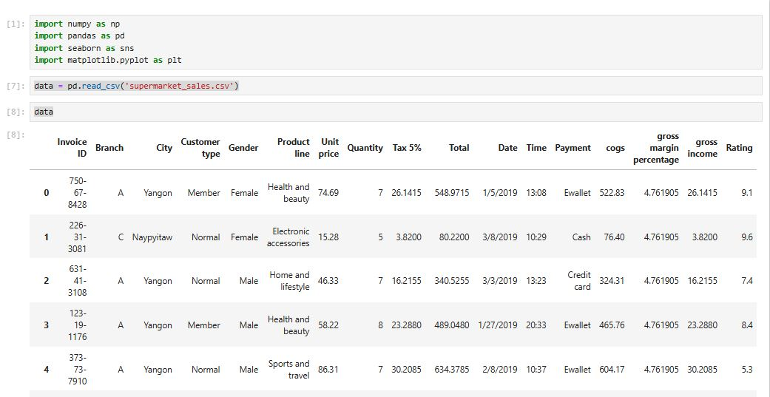
Import Data

Slide 7
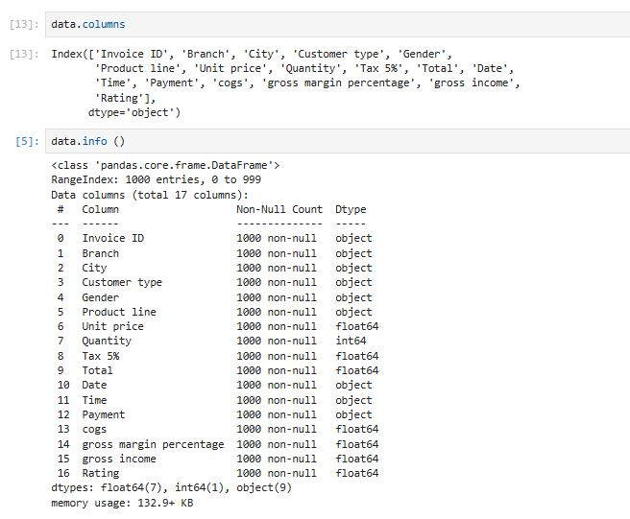
Columns names & info about data

Slide 8
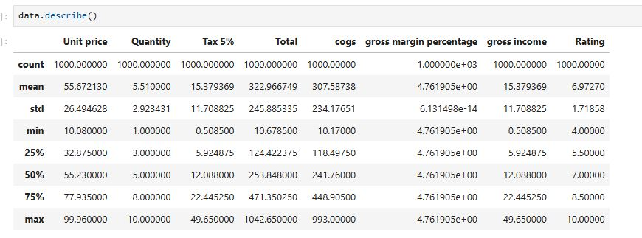
Describe data

Slide 9
Data Cleaning & Transformation
02

Slide 10
Data Cleaning Steps
Check for Missing Values
Identified null or missing values (there are no nulls or missing values).
Check for Duplicates
Detected duplicate rows (there are no duplicates).
Date Format Correction
Standardized date formats for consistency across the dataset (Replaced / with - in the Date column).
Add new column
GOGS /sales
Renamed Columns for Clarity
Renamed Total to Total Sales
Renamed Payment to Payment Method
Added Conditional Column for Time Classification
Created a new column to classify time-based entries into categories: Morning, Afternoon, Evening, and Night.

Slide 11
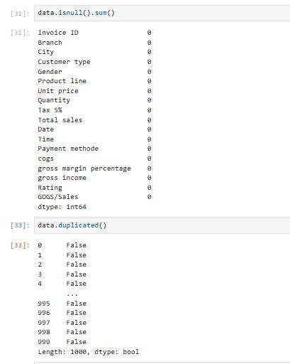
Check for Missing & Duplicates Values

Slide 12
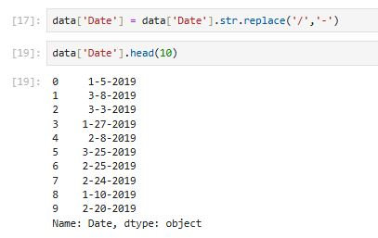
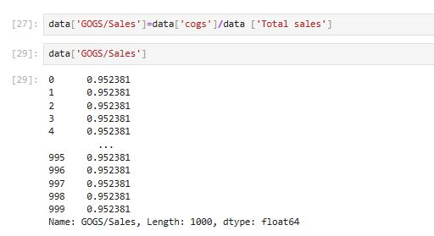
Date Format Correction& Add new column

Slide 13
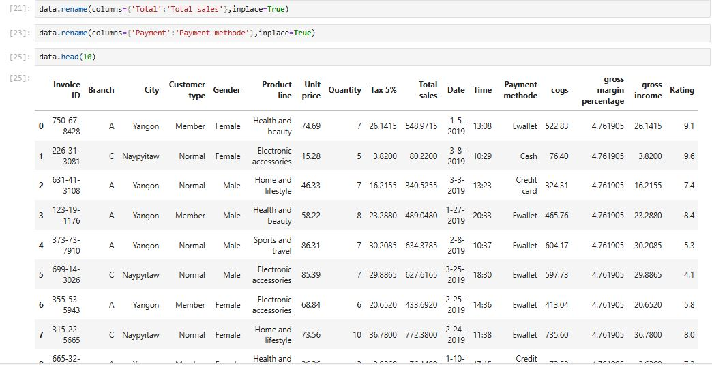
Renamed Columns for Clarity

Slide 14
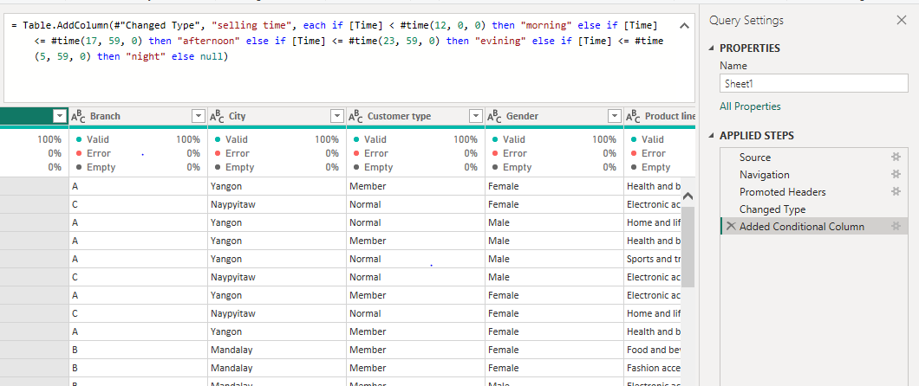
Added Conditional Column for Time Classification

Slide 15
Objectives Creation & Visualization
03
Tools USD : 1-Anaconda Navigator / Jupyter 2- SQL Server Management Studio 3-Tableau Public 2024
4-Power BI

Slide 16
Objectives for Supermarket Sales
Sales per month
Sales by gender
which customer type buys more?
which city or branch has the most sales?
Sales by products
Top products by quantity
Top products by profit
Top rated products
how customers prefer to pay (payment method)
Cogs to sales per month
The best-selling times
Relation between rating & profit /quantity
The average amount customers spend per invoice.

Slide 17

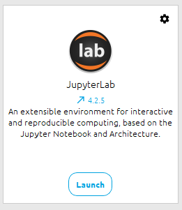
Using Anaconda Navigator / Jupyter

Slide 18
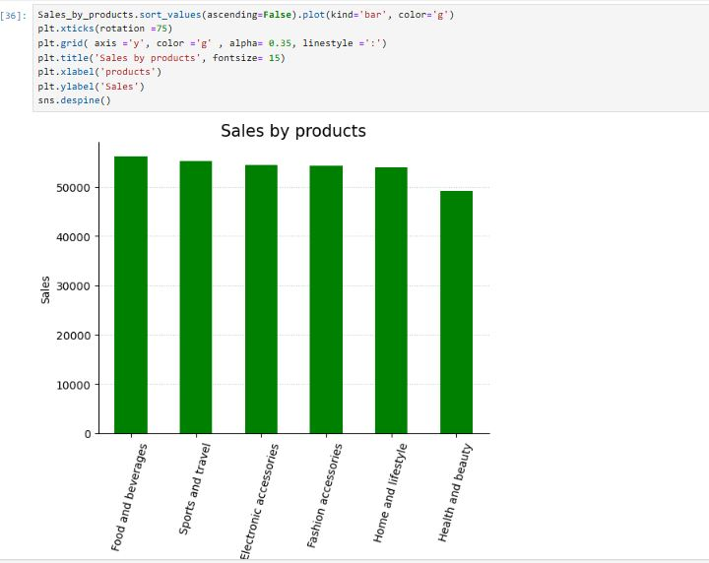

Slide 19
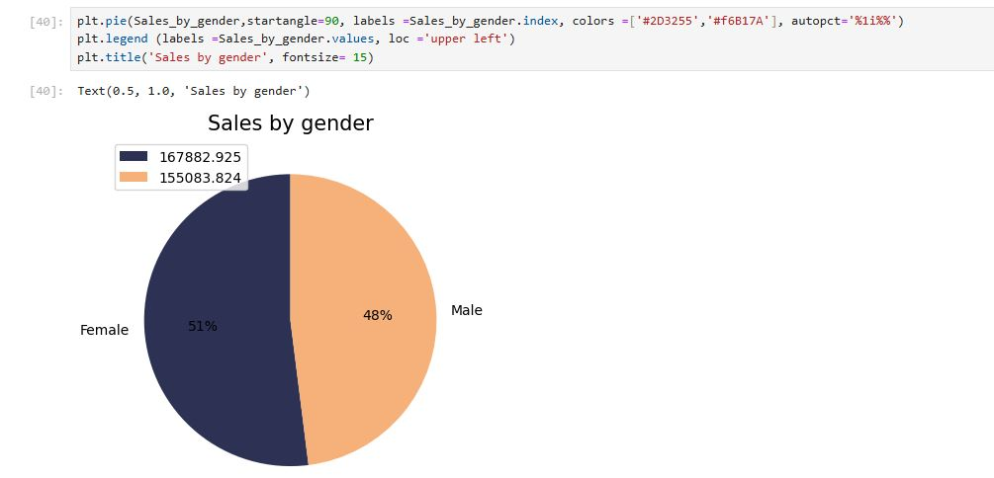

Slide 20
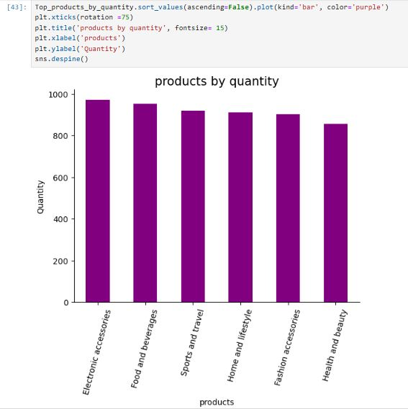

Slide 21
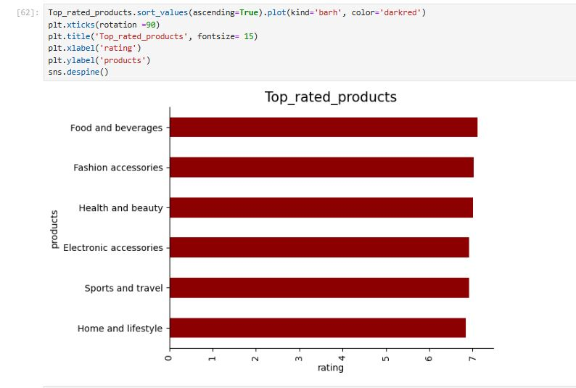

Slide 22
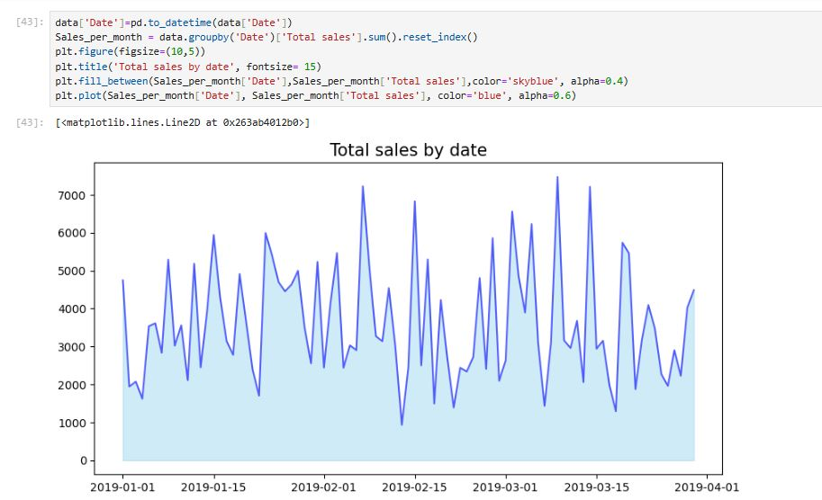

Slide 23
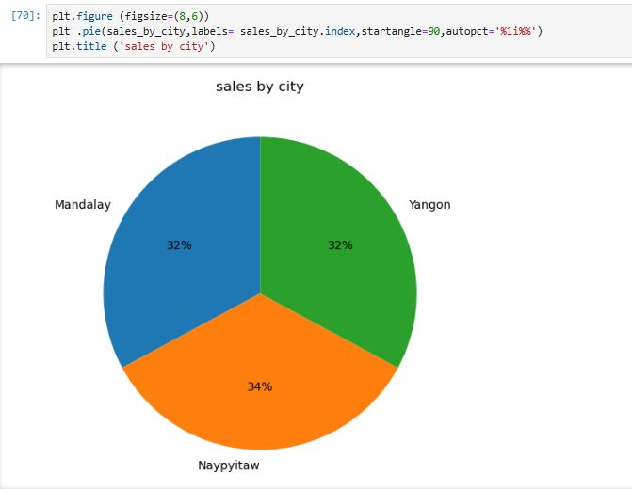

Slide 24
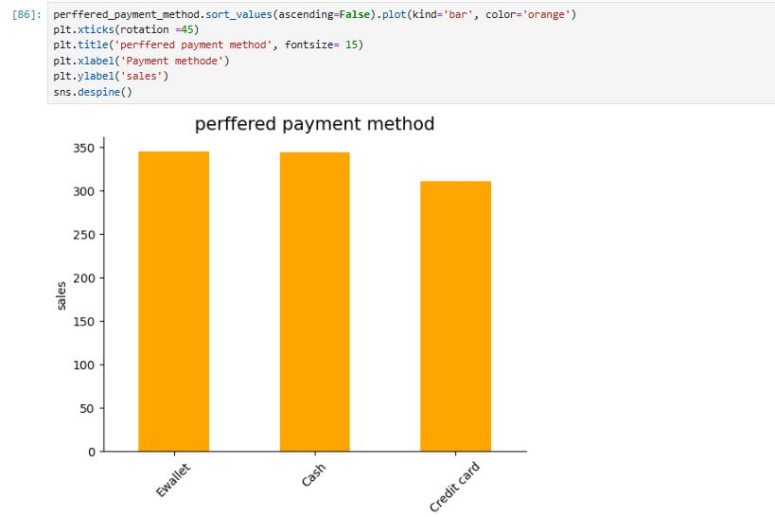

Slide 25
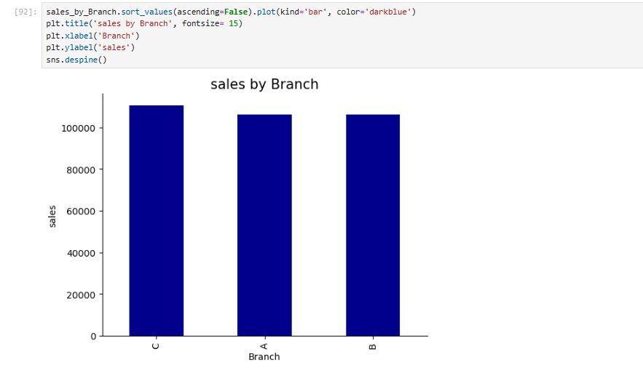

Slide 26
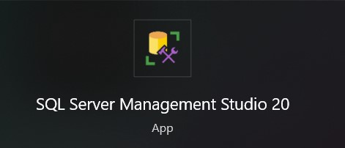
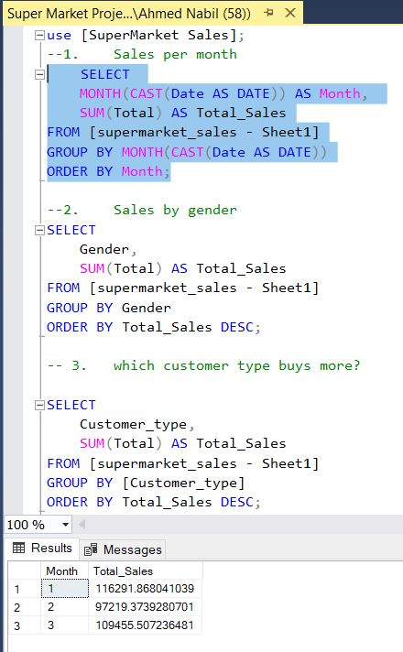
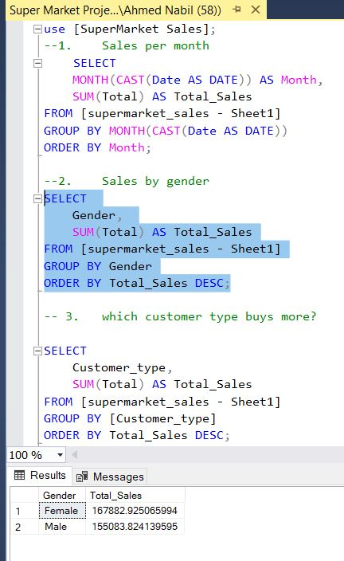
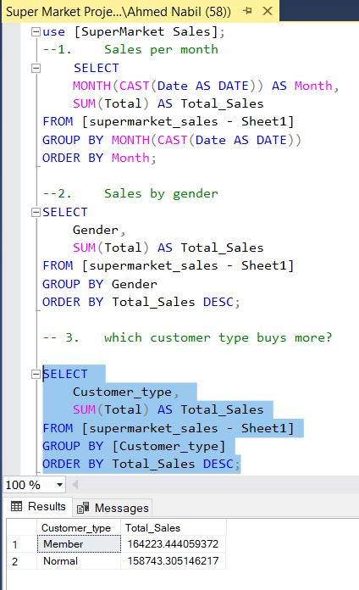
Using SQL Server Management Studio

Slide 27
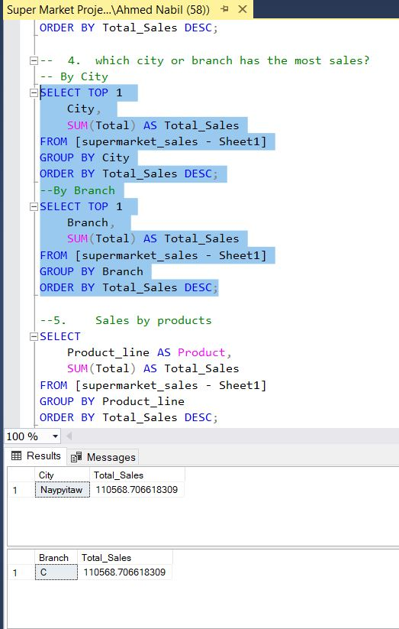
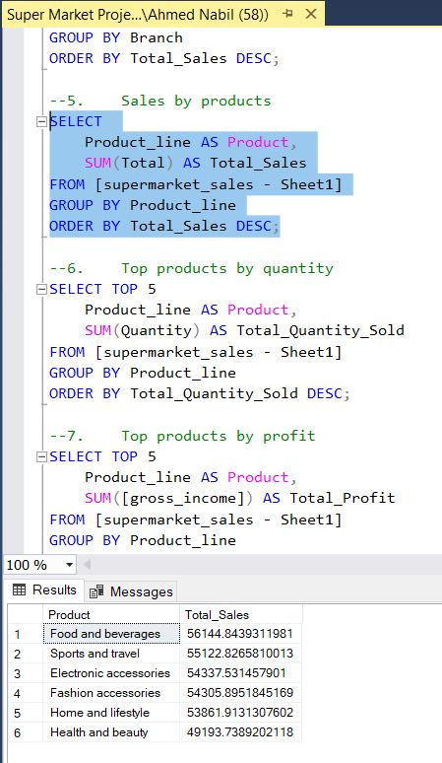
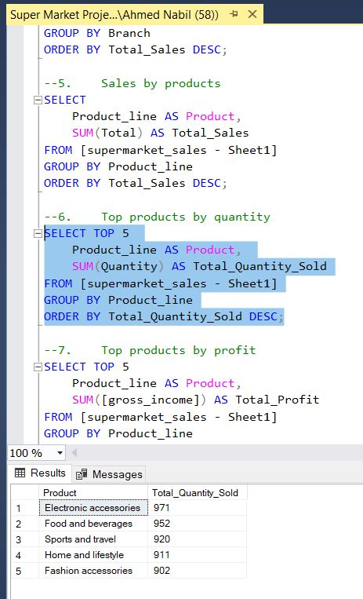
Using SQL Server Management Studio

Slide 28
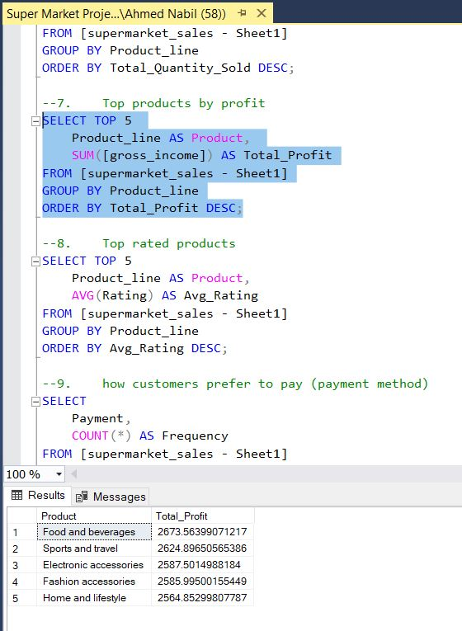
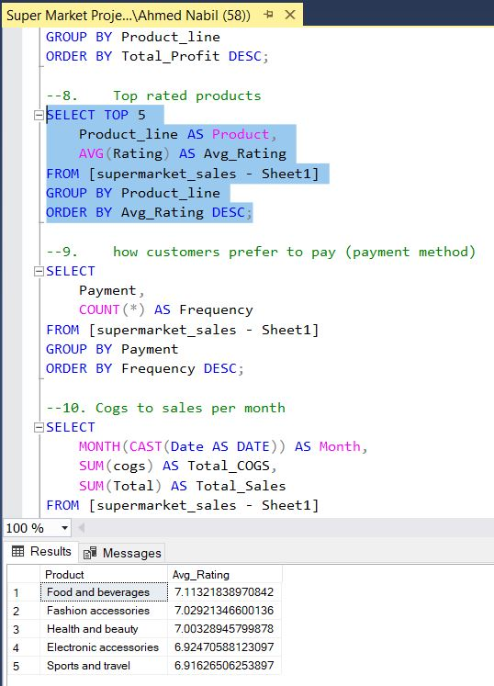
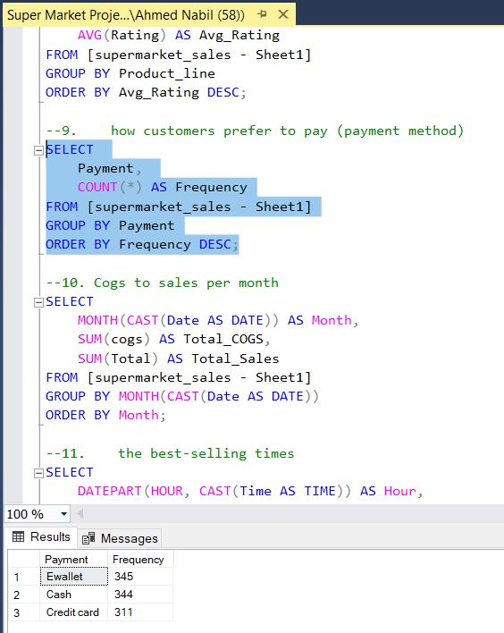
Using SQL Server Management Studio

Slide 29
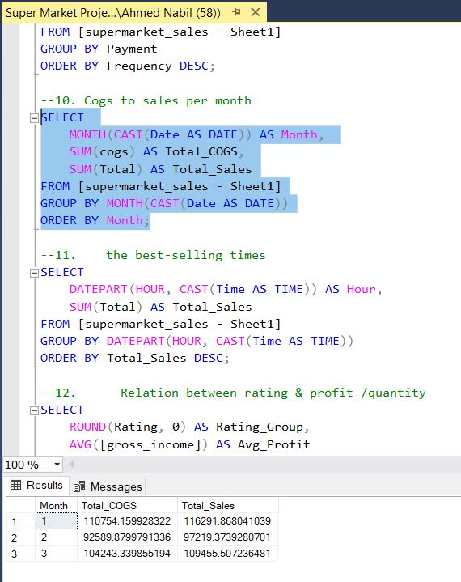
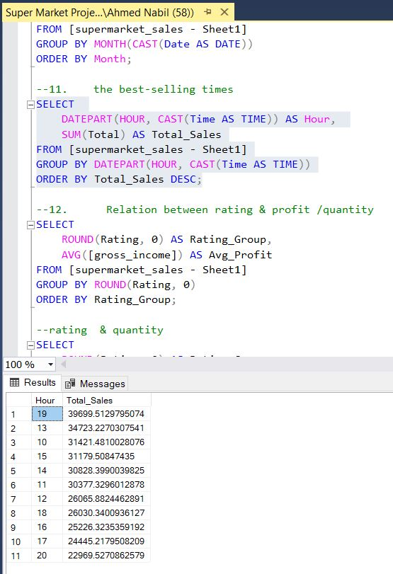
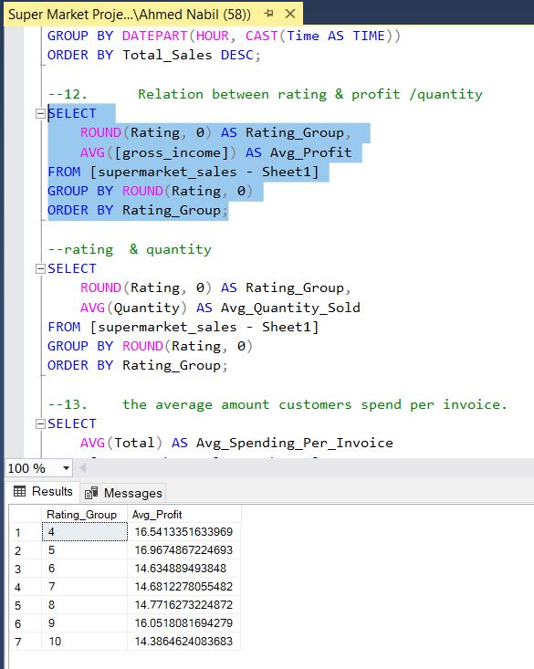
Using SQL Server Management Studio

Slide 30
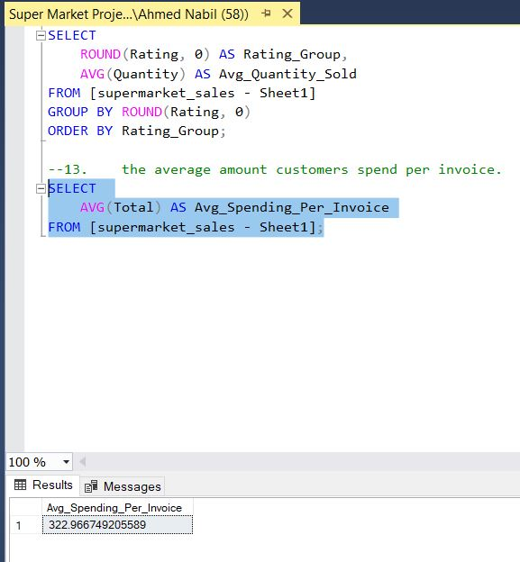
Using SQL Server Management Studio

Slide 31
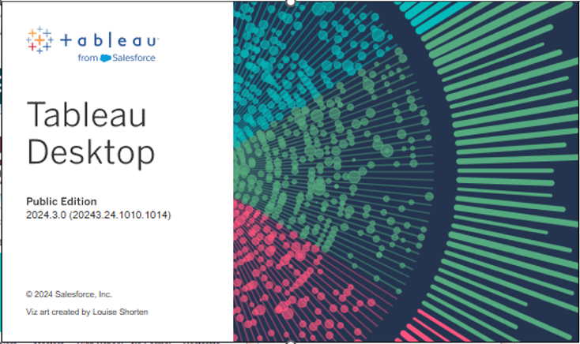
Using Tableau 2024

Slide 32
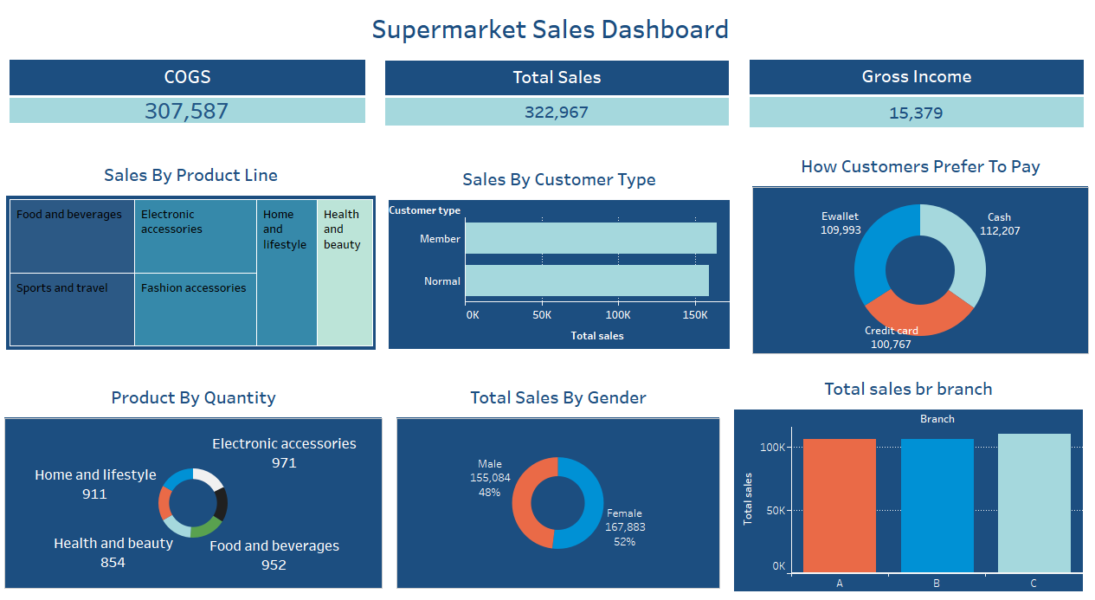

Slide 33

Using Power BI

Slide 34
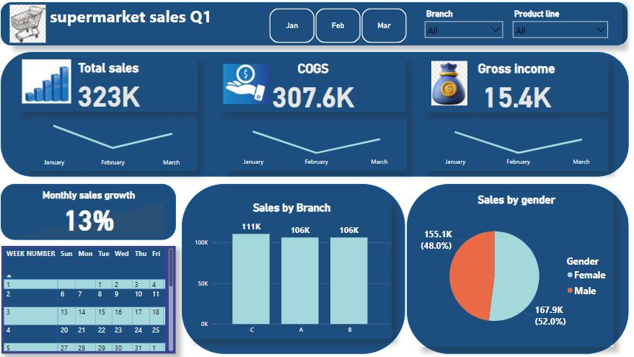
Using Power BI

Slide 35
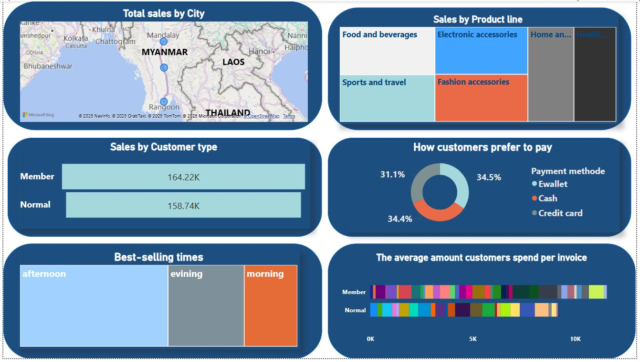

Slide 36
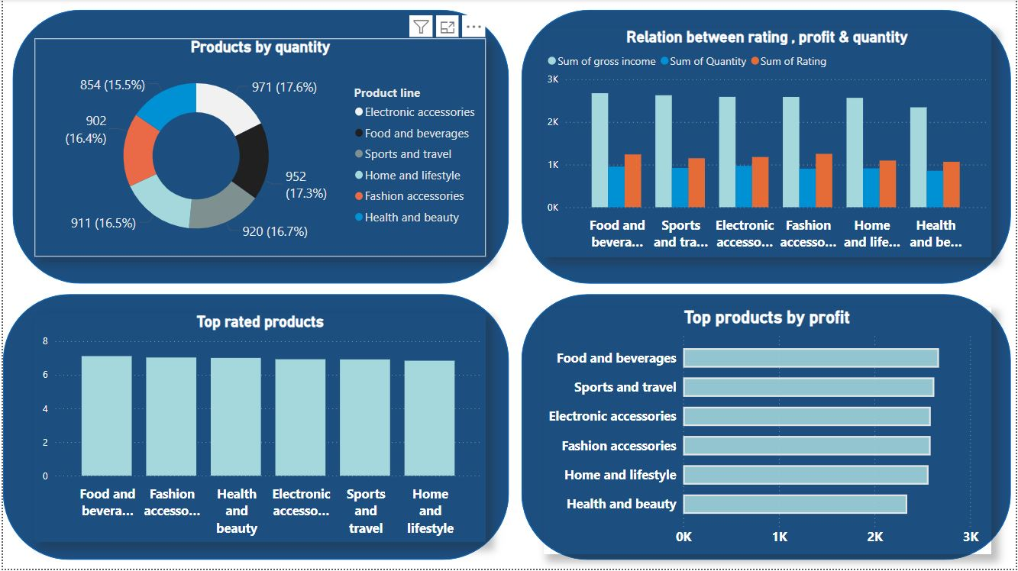

Slide 37
Key Insights & Conclusion
04
Final Conclusion of the Project

Slide 38
📊 Insights
🗓️ Monthly Sales Performance
January achieved the highest sales with a total of 116,292, followed by March with 109,456, and February with 97,219.
The drop in February could be attributed to fewer days or seasonal behavior (Christmas)
🏙️ City & Branch Performance
Naypyitaw (Branch C) led in sales (110,569) despite similar performance from Yangon (Branch A) and Mandalay (Branch B).
🛍️ Top Performing Product Lines
The highest revenue came from:
Food and Beverages – 56,145
Sports and Travel – 55,123
Electronic Accessories – 54,338

Slide 39
👩‍💼 Customer Demographics
Customer gender is balanced (52% Female, 48% Male).
👥 Customer Types
Members generated slightly higher revenue (164,223) than Normal customers (158,743), highlighting their value.
the average amount customers spend per invoice for Members is higher than for Normal.
💳 Payment Method Preferences
E-wallets (345) are the most used, followed closely by Cash (344) and Credit Cards (311).
Customers are fairly distributed across all payment types, though digital payments are slightly more popular.

Slide 40
⭐ Customer Ratings
Highest-rated product lines:
Food and Beverages (7.11)
Fashion Accessories (7.03)
Lowest-rated: Home and Lifestyle (6.84(

Slide 41
✅ Recommendations
🧭 Capitalize on Top Product Lines
Maintain inventory and promote Food & Beverages and Sports & Travel products.
Use bundles with popular items to encourage purchase & increase basket size
📅 Boost Sales in February
Consider launching seasonal promotions, loyalty offers, or flash sales in February to balance monthly revenue and combat seasonal dips.
🌍 Leverage Naypyitaw’s Success
Study and replicate strategies from Branch C (Naypyitaw) in other branches—could include staff performance, store layout, or marketing efforts.
🎯 Target Female Customers
Since females spend more, develop gender-specific marketing campaigns or exclusive product lines to increase engagement and retention.

Slide 42
🤝 Enhance Loyalty Program
With members contributing higher revenue, incentivize normal customers to join the loyalty program via:
Discounts
Early access to promotions
Points systems
📱 Promote Digital Payments
Since E-wallets are slightly leading, offer reward points to encourage digital payment
🔍 Investigate Product Ratings
Home & Lifestyle has the lowest customer rating, despite profitability.
Conduct customer surveys or focus groups to identify dissatisfaction points (quality, price, variety).

Slide 43
Thanks!
Do you have any questions?
Ahmed NAbil
abonabil87@gmail.com | +20109518765
Click Here To Check The Project Sources

